Slide 1





www.PES-Testing.com
637 Donohoe Road
Latrobe, PA 15650
Phone: 724-834-8848
Fax: 724-834-9151
Rapid Response. Dependable Delivery.
"Exceptional Turnaround From a Proven Partner in Materials Testing"

Slide 2






pes services
Mechanical Testing
Metallurgical Analysis
Chemical Analysis
Nondestructive Testing
Failure Analysis
Consulting

Slide 3
  Product Evaluation Systems, Inc. (PES) has been proudly serving customers since 1979.
  A fully accredited independent testing laboratory specializing in metals testing located in Latrobe, PA.
  Accreditations:
    ISO/IEC 17025 Certified through ANAB
    Nadcap (National Aerospace and Defense Contractors Accreditation Program)
  Customer Approvals:
    Aerojet Rocketdyne RC5166 (Material Testing)
    ATI Nuclear
    Curtiss-Wright Electro-Mechanical Division (EMD)
    GE Aviation (S-400)
    GE E50TF133 (Grain Size)
    Lockheed Martin: Corporate ID LM0479486
    Pratt & Whitney MCL (Appendix 56)
    Rolls Royce (sub-tier)
    Safran (AMS 2300)
  We pride ourselves on providing our customers with a quick turnaround and open communication with our customers to ensure that we meet, or exceed their needs every time.
About PES

Slide 4
Mission Statement
Critical to our Mission is ensuring data integrity and ethical decision-making while focusing on the needs of our customers and team members. In doing so, we continue to be an elite, growth-oriented independent testing lab with an adaptive approach to materials analysis.
Core Values
Vision
  Open, Honest, and Effective Communication
  Treating ALL with Respect
  Building Trust and Working Together as a Team
  Empowering Team Members
  Raising the Bar and Achieving Excellence in everything that we do
We aspire to partner with our clients to ensure a safer world for all.

Slide 5










Community
Involvement
**Contributions and donations are based on team member suggestions and/or organizations that impact our local communities and neighborhoods

Slide 6
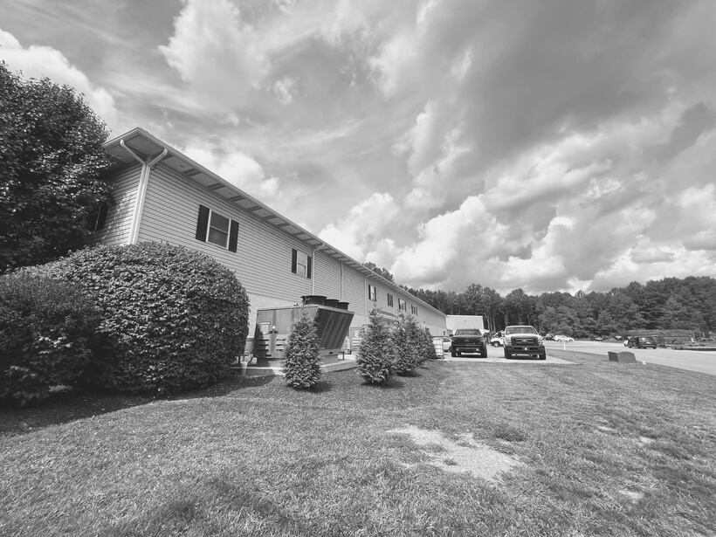
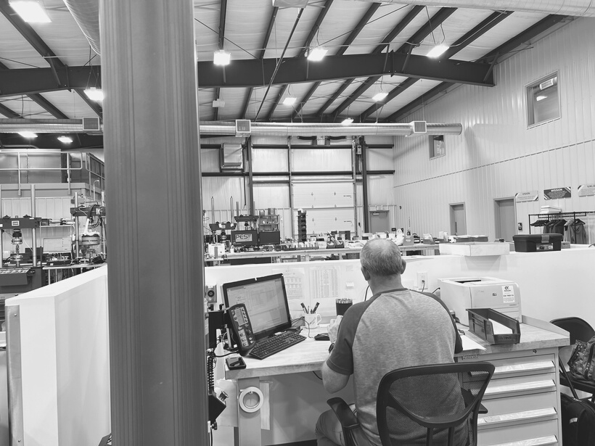
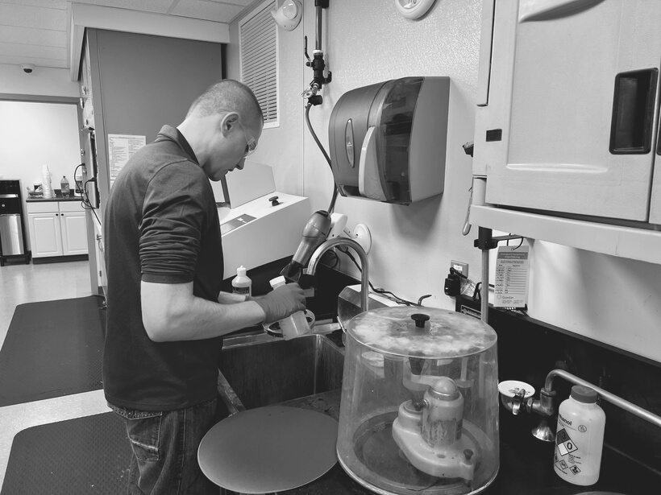
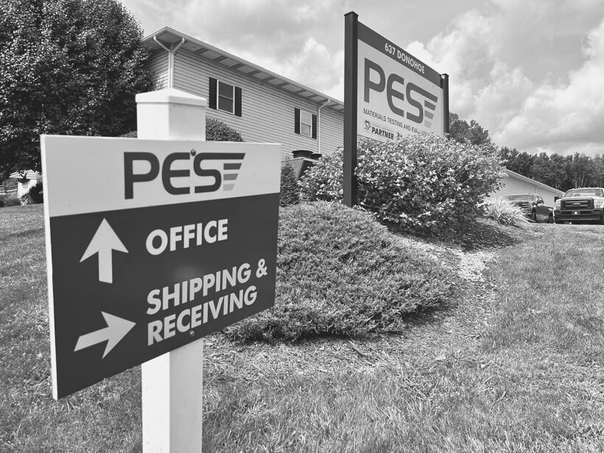
pes staff
and
Experience
  Expertise in machining, testing, and characterization of a wide variety of materials including, but not limited to:
    Carbon Steels
    Stainless Steels
    Nickel Alloys
    Titanium and Titanium Alloys
    Aluminum Alloys
    Brass and other Copper-Based Alloys
    Carbide Materials
    Additive Manufacturing (AM)
  Full failure analysis capabilities and consulting services
  Staff industrial experience in:
    Steelmaking, Power Generation, Aerospace, Naval Nuclear, Heavy Equipment Manufacturing, Welding/Weld Qualification, and Material Testing

Slide 7
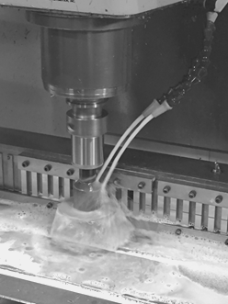
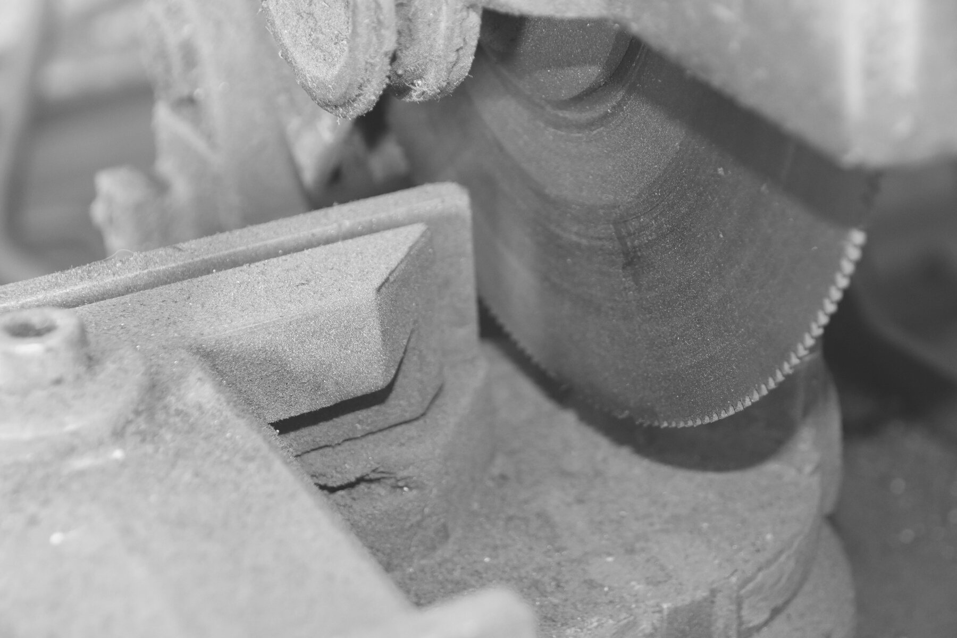
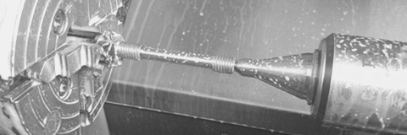
Machining Capabilities
  Saw Cutting and Sectioning
  Specimen Final Preparation
    Manual Turning
    Manual Milling
    CNC Turning
    CNC Milling
    Surface Grinding
    Wire EDM
    CNC Cylindrical Grinding
    Longitudinal Polishing
  Capabilities to design and machine custom fixtures to meet unique testing requirements

Slide 8
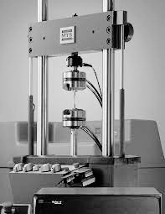
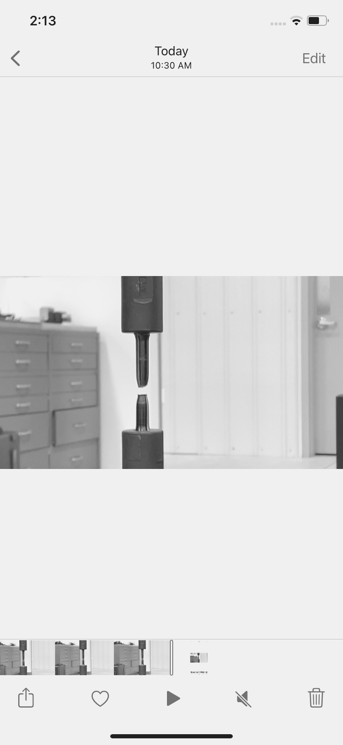

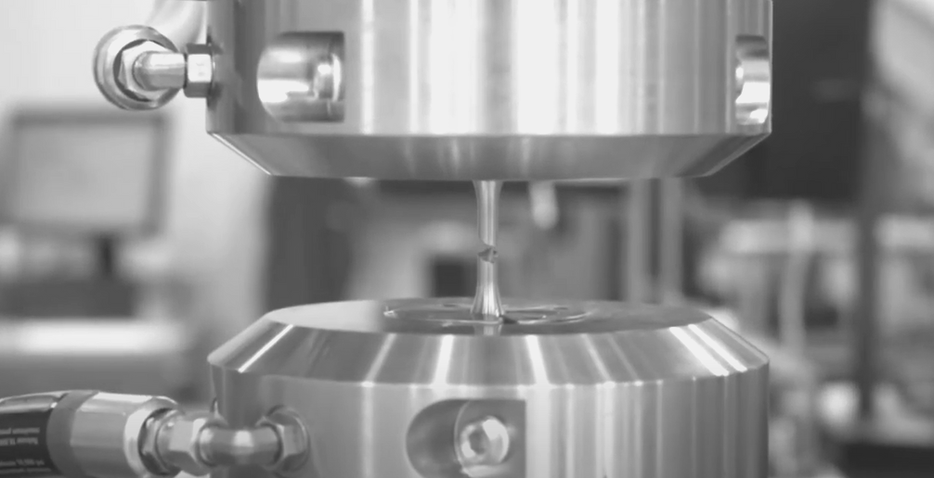
Mechanical Testing
  Tensile (Room and Elevated Temperature)
    Room Temperature - up to 220,000 lbf
    Elevated Temperature - up to 90,000 lbf
    Temperature Ranges: -320°F, -300°F, up to +2000°F
  Charpy Impact
    Temperature Ranges: -320°F, -250°F up to 575°F
  Bend (Free and Guided) per ASTM and ASME
  Creep and Stress Rupture
    Up to 6000 lbf capacity
    Creep up to 1500°F, Stress Rupture up to 2000°F
  Hardness
    Brinell & Rockwell
  Drop Weight (ASTM E208)
    Determine Nil-ductility transition temperature of Ferritic steels within 10°F
    Temperature Ranges: -320°F, -250°F up to 575°F
  Jominy (ASTM A255)
    Determine the hardenability of various steel alloys using specific heat treatments based upon carbon content

Slide 9
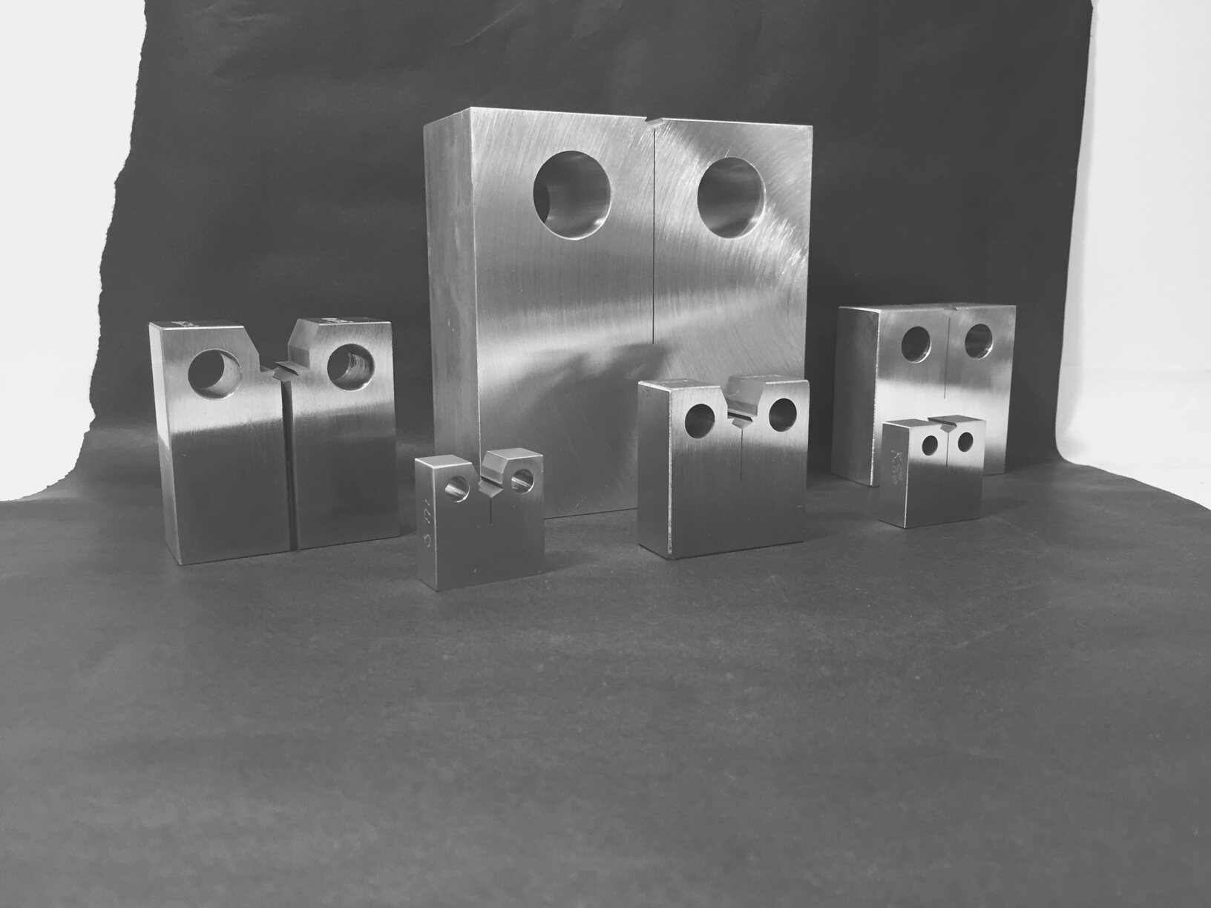
  Fracture Mechanics
    K1c, J1c , CTOD, FCGR
    Up to 100,000 lbf
    -320°F, -300°F, up to 400°F ; all sizes
      0.50" and 0.75" C(T) up to 1600°F
    Custom test and analysis programs available
    Large selection of specimen sizes
      C(T) Specimens (0.50" - 2.00")
      SE(B) Specimens (W = 0.50" to 4.00")
Mechanical Testing

Slide 10
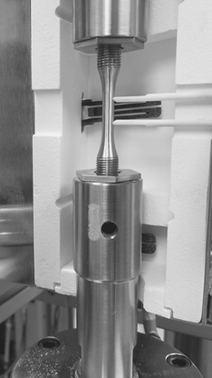
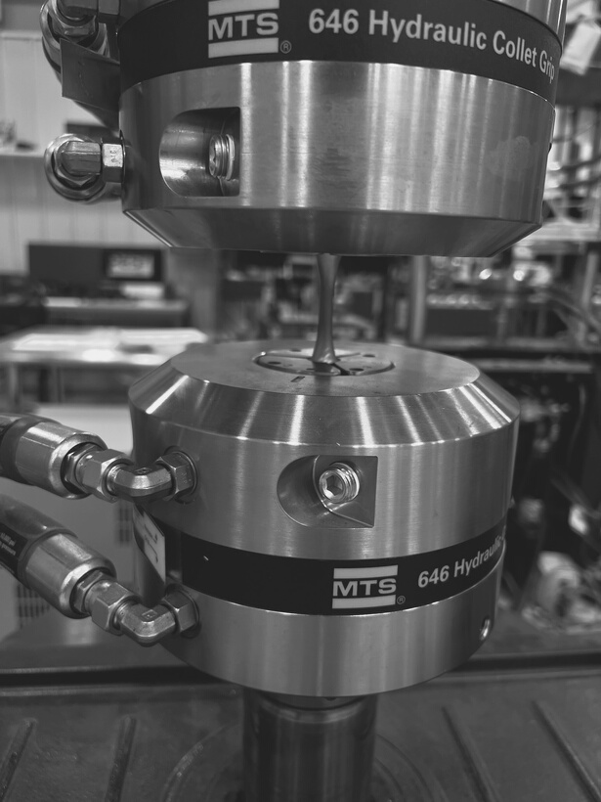
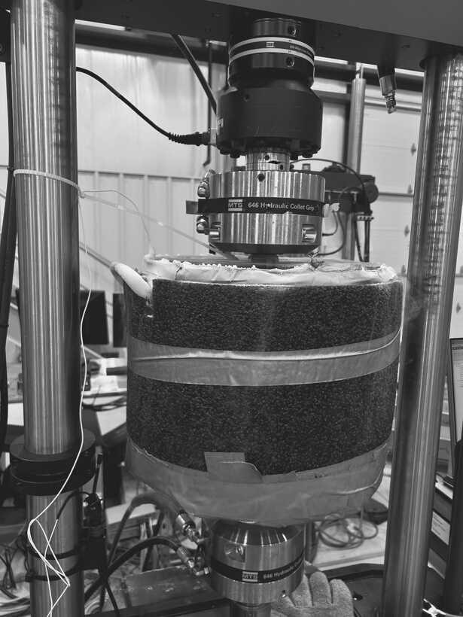
Mechanical Testing
  High Cycle Fatigue
    -320°F, -300°F, up to 1800°F
    All Load Ratios
    Up to 30Hz
  Low Cycle Fatigue
    -320°F, -300°F, up to 1800°F
    All Strain Ratios
    Strain Control up to 2Hz
    Stress Control up to 30 Hz
  Cyclic Stress-Strain
    Room Temperature up to 1800°F
    Customizable Steps
  Higher Frequencies with Positive R-Ratios

Slide 11
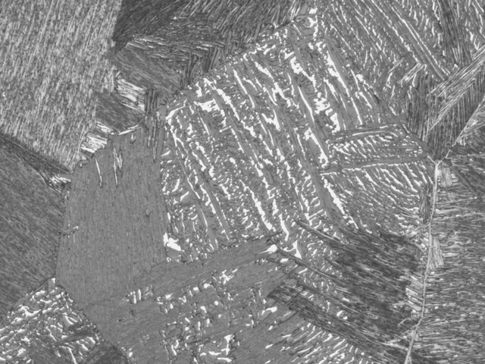
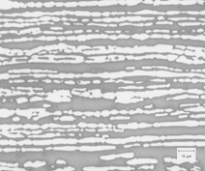
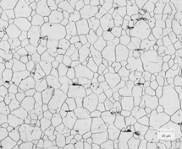
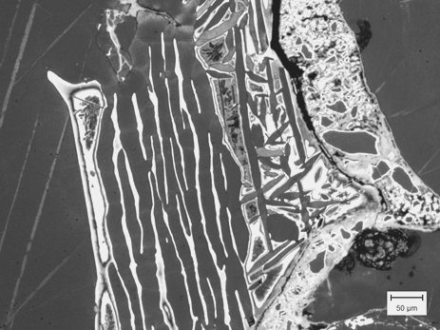
Metallographic Analysis
  Microstructural Evaluation
    Inclusion Ratings
    Porosity Phase or Percentage
    Case & Decarburization Depth
    IGA/IGO
    Coating Characteristics
    Surface Contamination
      Alpha Case/Alloy Depletion
  Grain Size
    Per ASTM E112, E1181, & GE E50TF133
  Microindentation Hardness
    Vickers (Macro/Micro), Knoop
  Macroetch Examination
  Etch - Anodize Inspection of Titanium
    Per AMS 2642 (Blue Etch)
  Corrosion Analysis
  Scanning Electron Microscopy (SEM)
    SE and BSE Detectors
    EDS Chemical Analysis
  Microprobe Availability

Slide 12
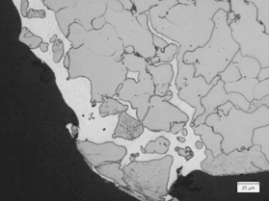
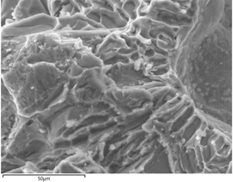
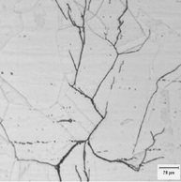
Failure Analysis & Consulting
  Variety of Failure Investigations:
    Field Failures
    Processing Defects
    Root Cause Investigations
    Heat Treatment Issues
    Improvements in Material/Design
  Range of Metallurgical Consulting:
    R&D Projects
    Process Optimization
    Alternate Alloy Selection or Design Changes
  Project Management:
    Manage any outsourcing needs
    Coordinate sub-tier schedules and deliverables

Slide 13
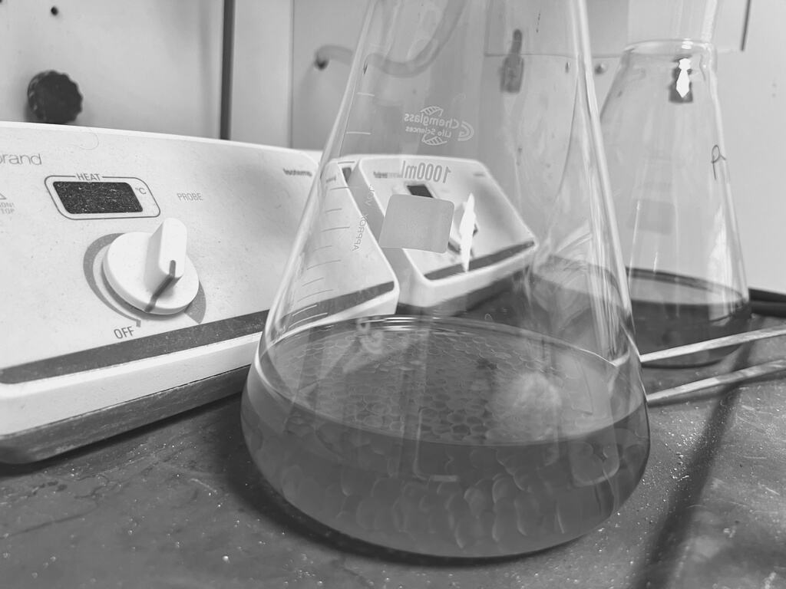
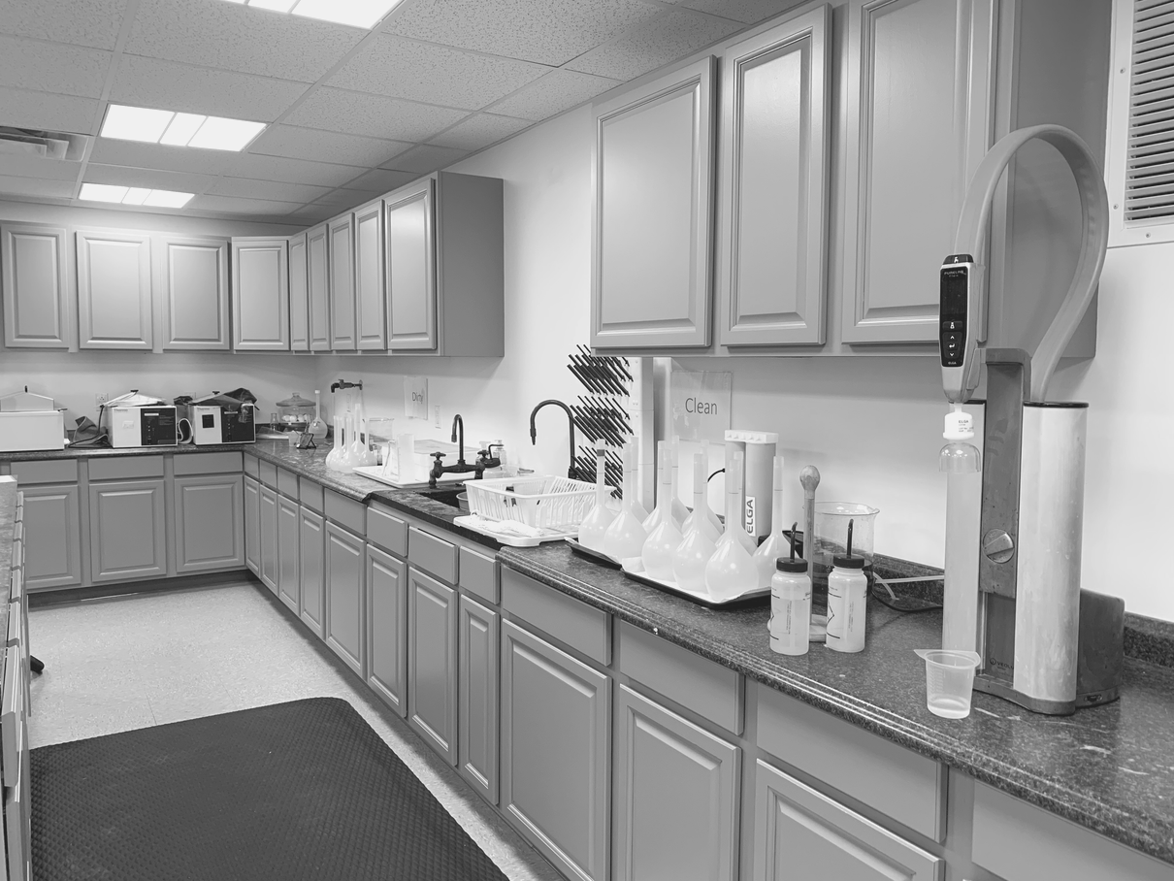
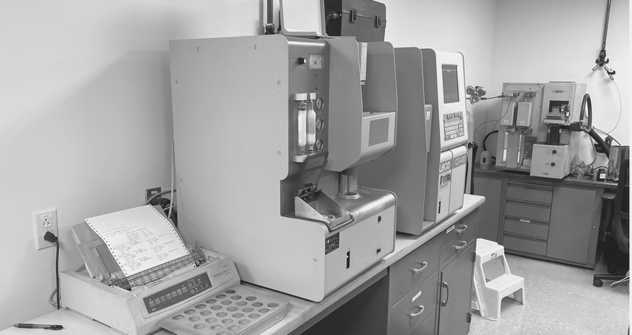
Chemical Analysis
  Inductively Coupled Plasma (ICP)
  Optical Emission Spectroscopy (OES-Spark)
  LECO Combustion Analysis:
    Carbon
    Sulfur
    Oxygen
    Hydrogen
    Nitrogen
  Analysis of recycled / reclaimed materials
  Standards for: Carbon Steel, Stainless, Nickel, Titanium, Aluminum, Cobalt, and Copper Alloys
    Custom standards produced as needed

Slide 14
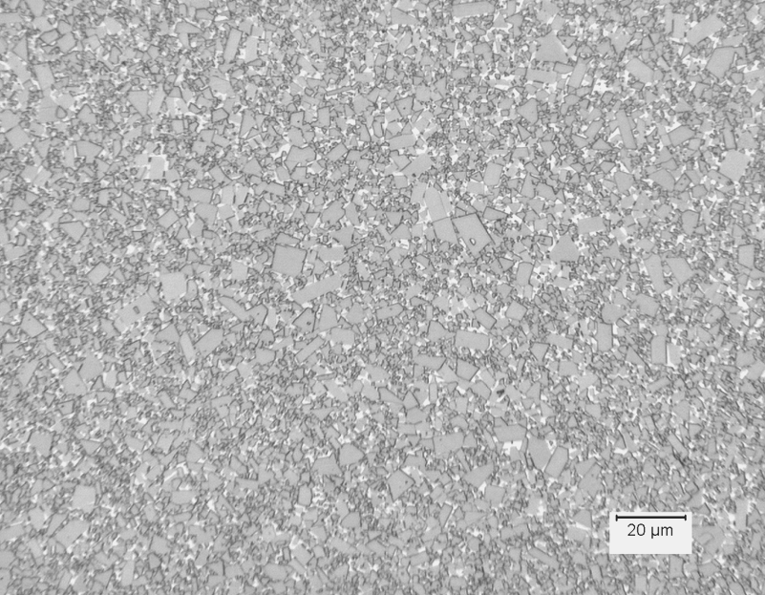
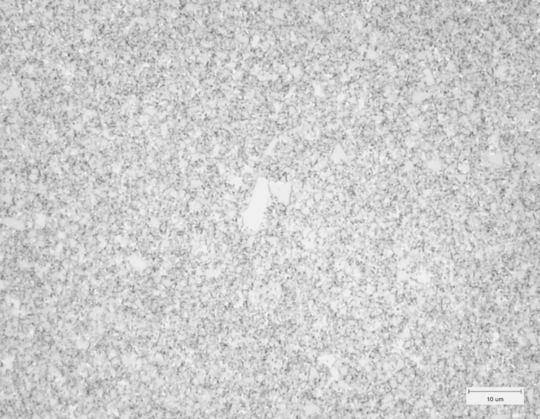
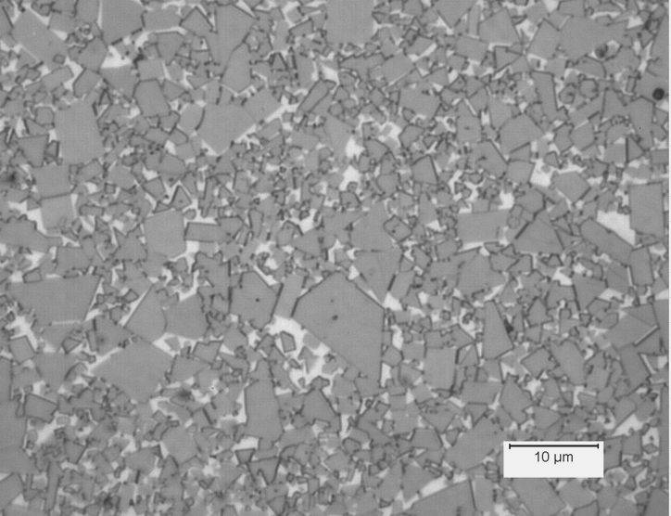
  Density (ASTM B311)
  Apparent Grain Size (ASTM B390)
  Apparent Porosity (ASTM B276)
  Microstructural Evaluation (ASTM B657)
  Transverse Rupture Strength (ASTM B406)
  Chemistry
Carbide Analysis

Slide 15
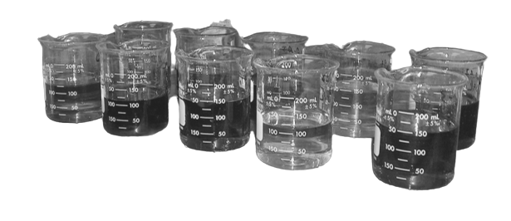
Corrosion Testing
  Variety of corrosion tests for stainless steels
    Ferric Chloride (ASTM A923 & G48)
    Sulfuric Acid and Copper Sulfate (ASTM A262 Method E)
    Nitric Acid (ASTM A262 Method C)
    Ferric Sulfate-Sulfuric Acid Test (ASTM G28)
  Multiple Test Stations:
    Quick Turnaround
    Short and long exposure tests

Slide 16
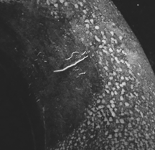
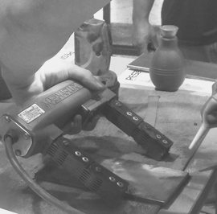
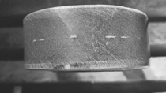
Nondestructive Testing
  Nadcap Capabilities:
    Magnetic Particle Testing (MT)
    Liquid Penetrant Testing (PT)
    Subcontracted:
      X-Ray Testing (RT)
      Ultrasonic Testing (UT)
  Personnel Certifications:
    ASNT-TC-1A
    NAS 410

Slide 17
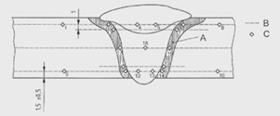
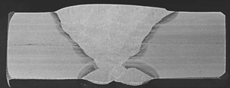
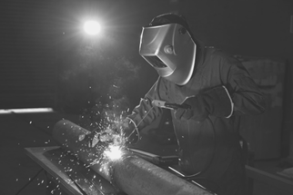
Weld Qualification Services
  Weld Procedure Qualification
  Welder Performance Qualification
  Weld/HAZ/Base Metal Characterization
    Mechanical and Metallurgical Testing
    NDT Inspections
    Filler Metal Chemical Analysis
    Macroetching
    Microindentation Hardness Traverses
    PWHT

Slide 18
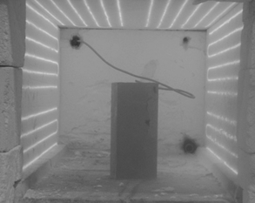
  Nadcap Furnaces (± 15°F)
  Max Working Zone: 13.5" W x 14" H x 27" D
  Temperature Range: 200°F to 2200°F
  Programmable Heating and Cooling Rates
  Exportable Time-Temperature Data
  Cooling Methods
    Air Cool
    Fan Cool
    Oil Quench
    Water Quench
  Specimen Prep, R&D, PWHT (Weld Qualification)
Heat Treatment

Slide 19
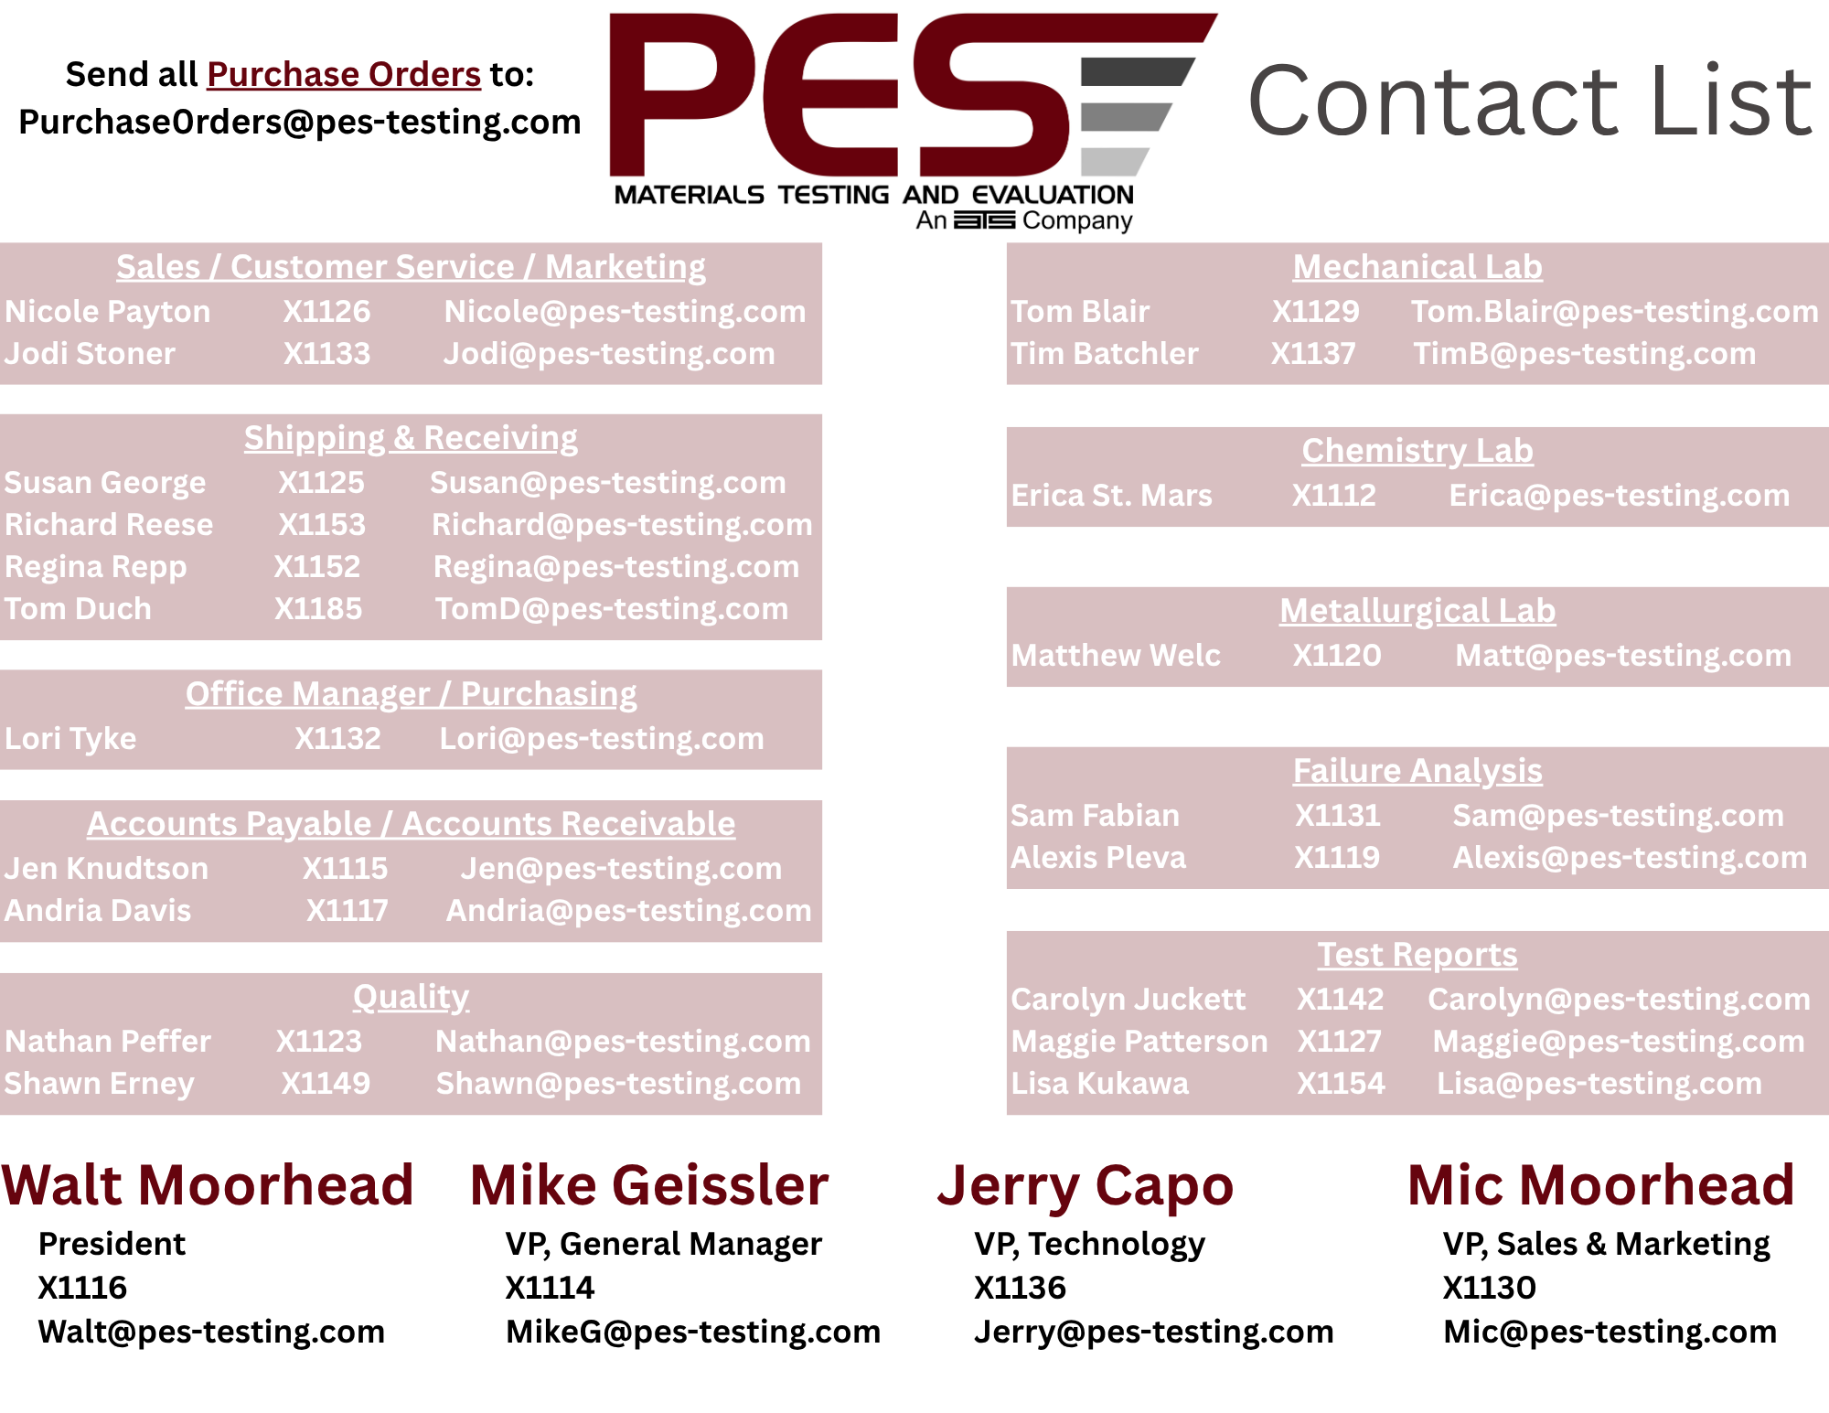
Contact List

Slide 20


Connect With Us
PRODUCT EVALUATION SYSTEMS
@PESTESTING
WWW.PES-TESTING.COM | 724-834-8848 | 637 DONOHOE ROAD LATROBE, PA 15650

